Slide 1
MIDDLETON CHENEY
FOOTBALL CLUB

Slide 2
FIRST TEAM
1946-47
SEASON
OXFORD JUNIOR LEAGUE
AND CUPS

Slide 3
April 26th 1947 Tysoe Challenge Cup Final Played at Tysoe
King Sutton 0 v 1 Middleton
A. Turvey
H. Gibbard
R. Merry
E. Watkins
L. Fortnum (Capt)
G. Merrivale Goal Scorer R. Christie
F. Bidwell
R. Christie
T. Barnes
J. Christie
G. Barnes
Ref Mr G P Haynes
Lines Men

Slide 4
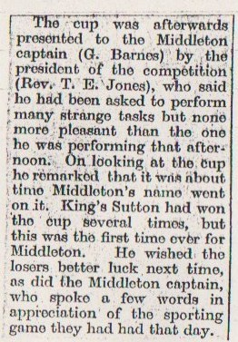

Slide 5
May 3rd 1947 Brackley (Myers) Charity Cup Final Played at Brackley
Brackley 0 v 3 Middleton
A. Turvey
H. Gibbard
S. Baker
E. Watkins
L. Fortnum (Capt)
G. Merrivale Goal Scorer G. Barnes
F. Bidwell R. Christie
R. Christie T. Barnes
T. Barnes
J. Christie
G. Barnes
Ref Mr G C Haynes
Lines Men

Slide 7
May ? 1947 Buckingham Charity Cup Final Played at Buckingham
Steeple Claydon 2 v 4 Middleton
A. Turvey
H. Gibbard
B. Merry
E. Watkins
L. Fortnum (Capt)
G. Merrivale Goal Scorer T. Barnes 2
G. Barnes R. Christie 2
R. Christie
T. Barnes
J. Christie
S. Baker
Ref Mr A Boulton
Lines Men

Slide 9
May 24th 1947 Banbury Charity Cup Final Played at Spencer Stadium Record Gate At Final 2400
King Sutton 1 v 2 Middleton
A. Turvey
H. Gibbard
B. Merry
E. Watkins
L. Fortnum (Capt)
G. Merrivale Goal Scorer R. Christie
G. Barnes T. Barnes
R. Christie
T. Barnes
J. Christie
S. Baker
Ref Mr F Allitt
Lines Men

Slide 10
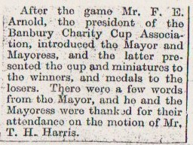

Slide 11
May 7th 1947 Banbury Guardian Cup Final Played at Spencer Stadium
Deddington 1 v 2 Middleton
A. Turvey
H. Gibbard
B. Merry
E. Watkins
L. Fortnum (Capt)
G. Merrivale Goal Scorer J. Christie
F. Bidwell T. Barnes
R. Christie
T. Barnes
J. Christie
S. Baker
Ref Mr E P Haines
Lines Men Mr C V Mawle & Mr J Powell

Slide 13
Continued next page

Slide 14
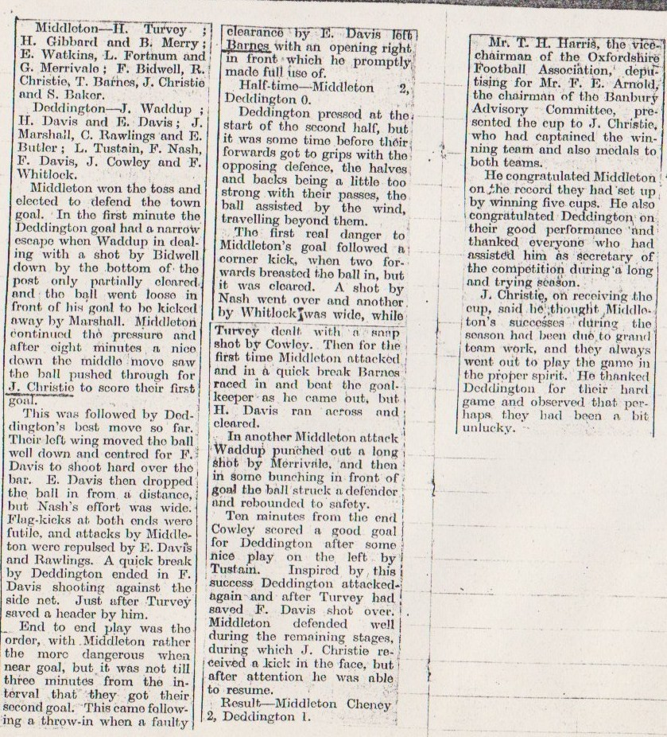

Slide 15
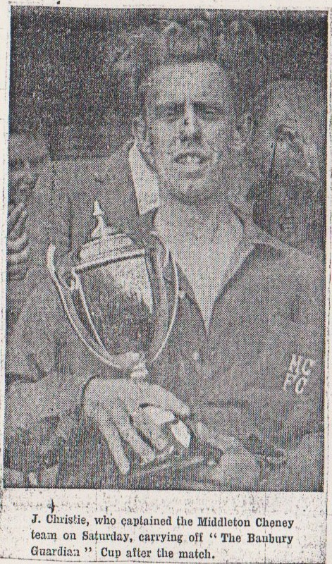

Slide 16
